Slide 1
Data Governance z Databricks Unity Catalog - raport z wdrożenia
Tomasz Krawczyk
Data Architect/ Data Engineer

Slide 2
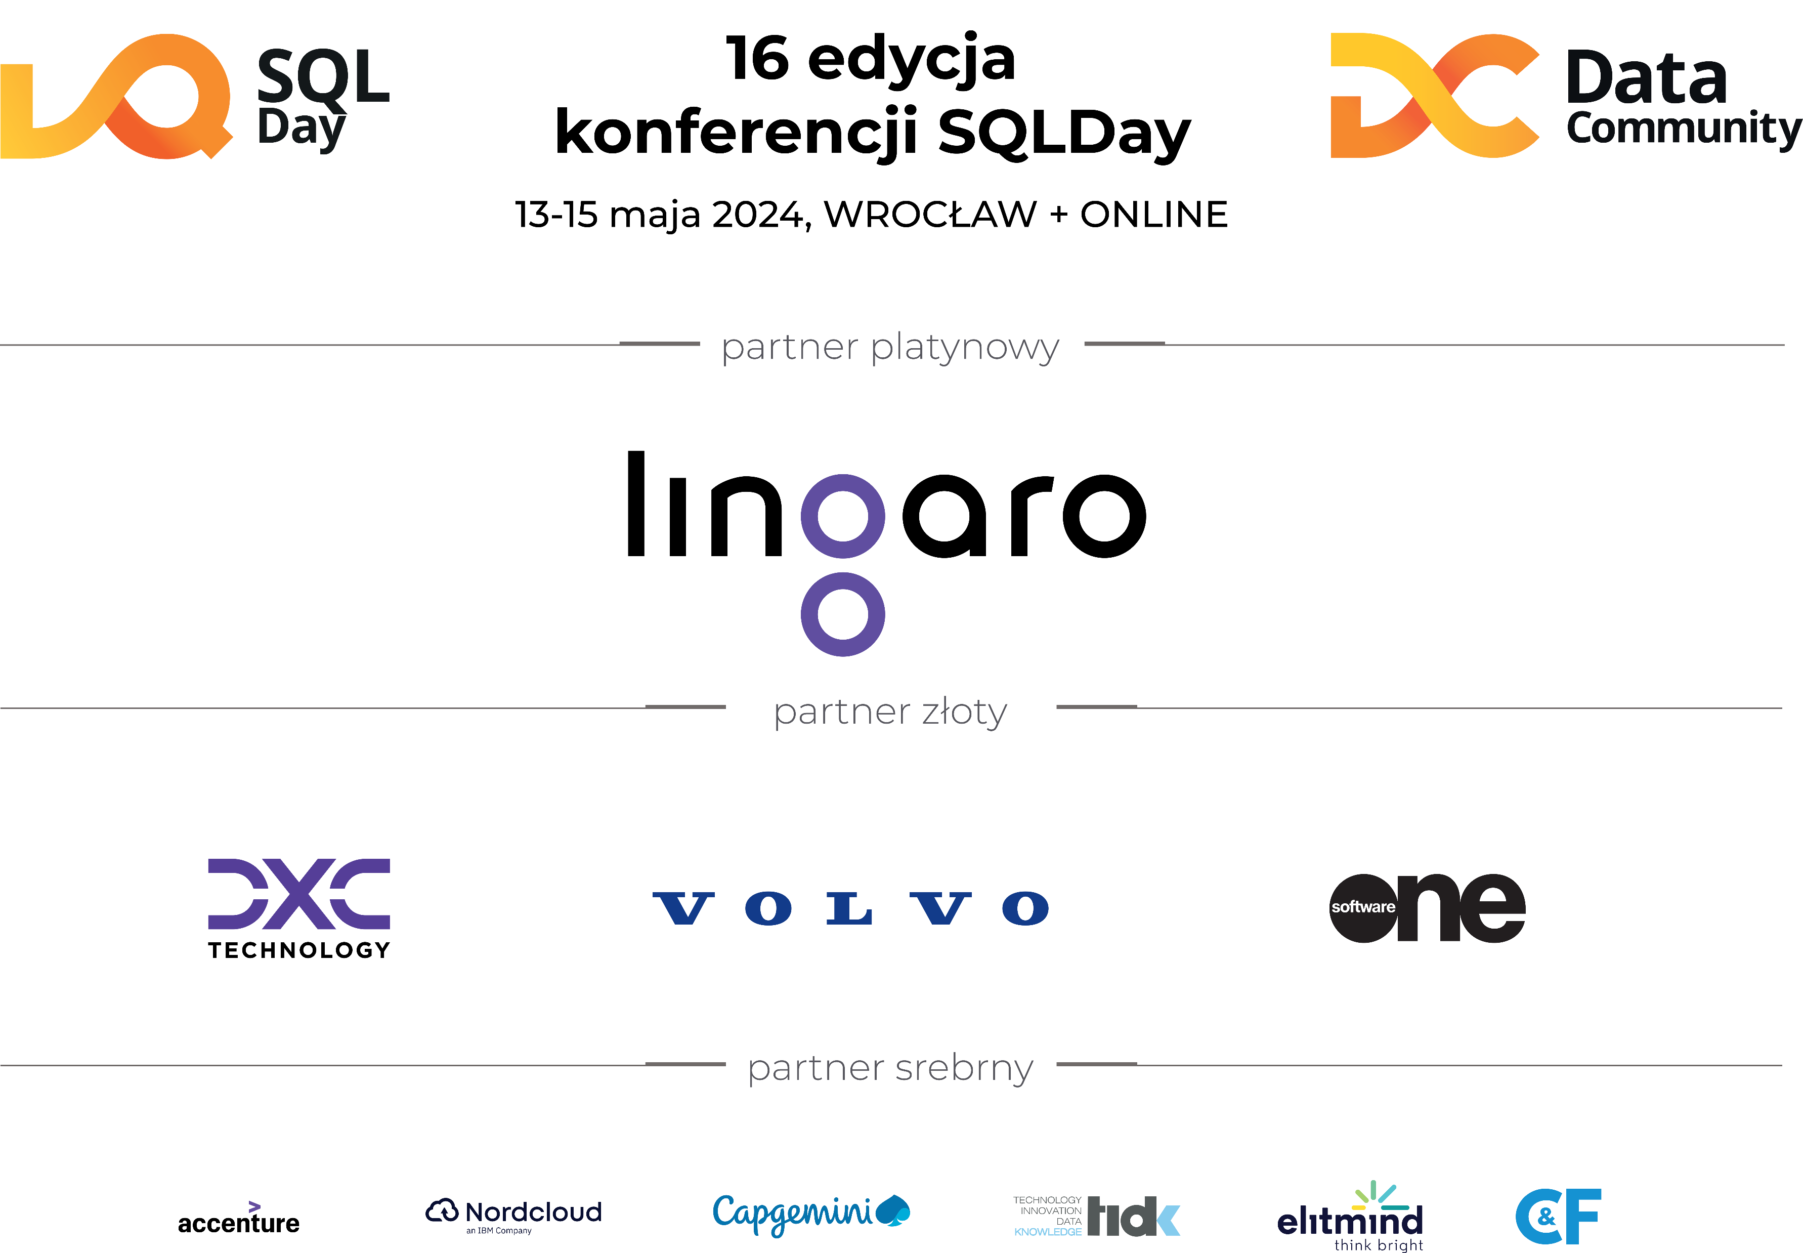

Slide 4
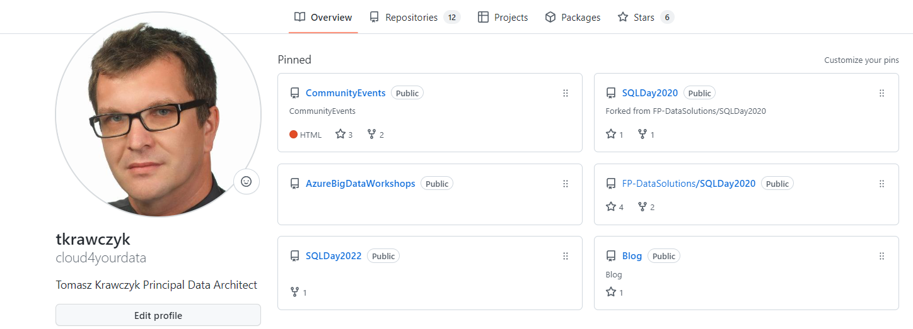



Data Architect/Data Engineer
Future Processing Data Solutions (>10 years)
Data Lakehouse Enthusiast
https://github.com/fp-datasolutions
https://github.com/cloud4yourdata/CommunityEvents
tkrawczyk@future-processing.com
tomasz.k.krawczyk@gmail.com

Slide 5
Agenda
Overview of Data Governance
Databrick Unity Catalog and Data Governance
Unity Catalog Key Concepts
Migration to Unity Catalog
Migration Strategy
Assess current data architecture
Prepare the Unity Catalog environment
Migration …
Unity Catalog - Benefits
Demo(s)
Q&A

Slide 6
Data Governance
What is Data Governance?
“Data Governance is a principled approach to managing data during its life cycle, from acquisition to use to disposal.”
“You can think of Data Governance as introducing Rules, Processes, and Accountability that allow the organization to better manage the availability, usability, security and integrity of corporate data sources”
DAMA-DMBOK2

Slide 7
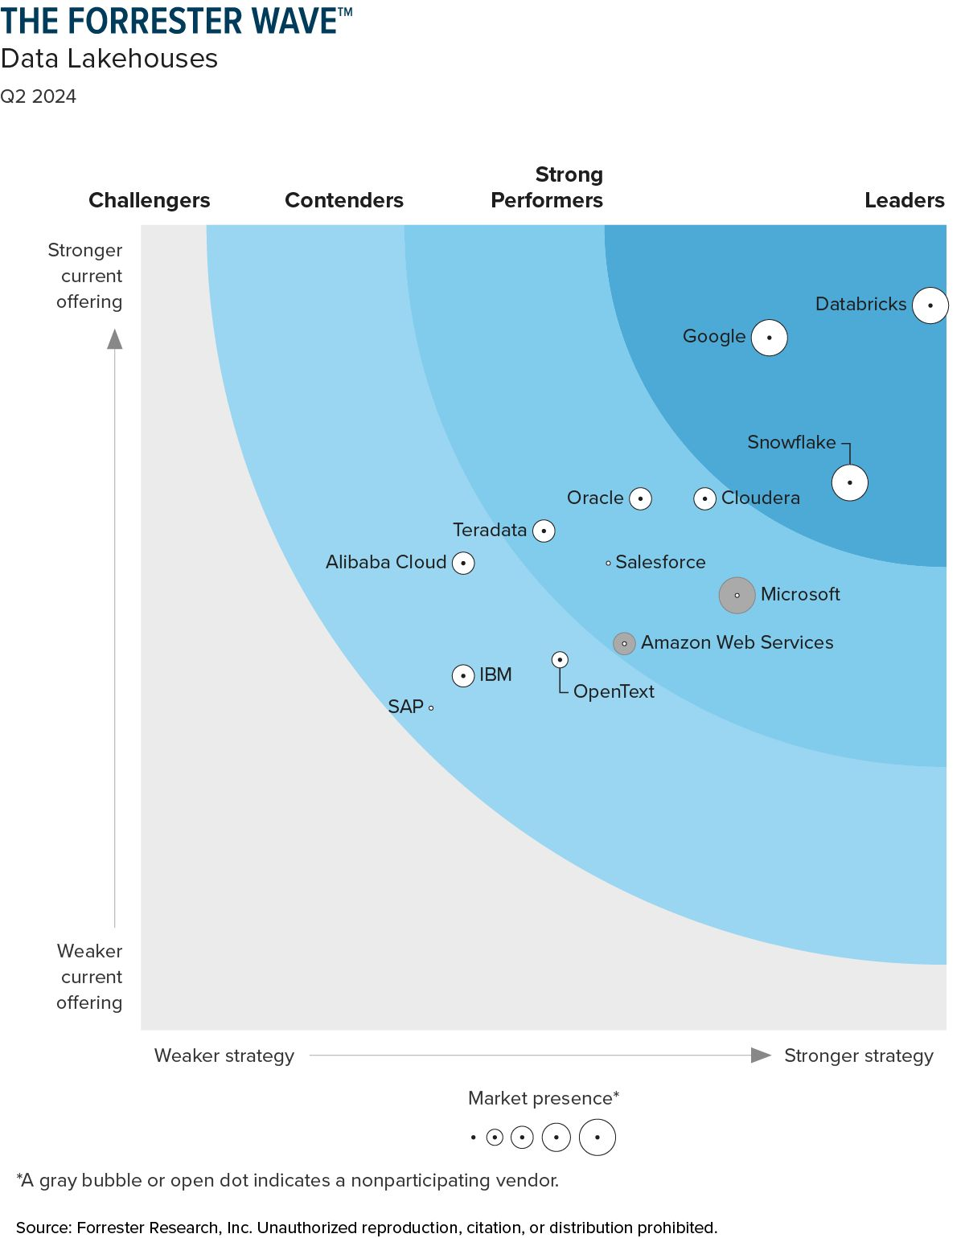
Data Governance by Databricks
Four key functional areas:
Data Access Control
Data Access Audit
Control who has access to which data
Capture and record all access to data
Data Lineage
Data Discovery
Capture upstream sources and downstream consumers
Ability to search for and discover authorized assets

Slide 8

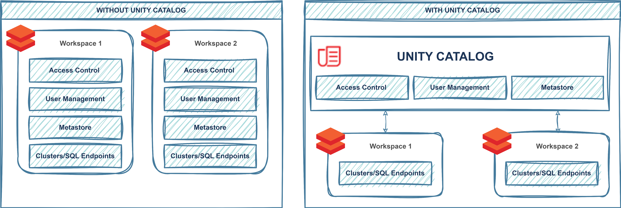
Data Governance by Databricks
Challenges (before Unity Catalog):
Complexity due to Permissions on Files
Permissions on Objects (Databases, Tables, Views,…)
Permissions on Columns, Rows
Permissions on ML models, dashboards, features
Auditing
Local permission management
Unity Catalog provides centralized access control, auditing, lineage, and data discovery
capabilities across Databricks workspaces.

Slide 9
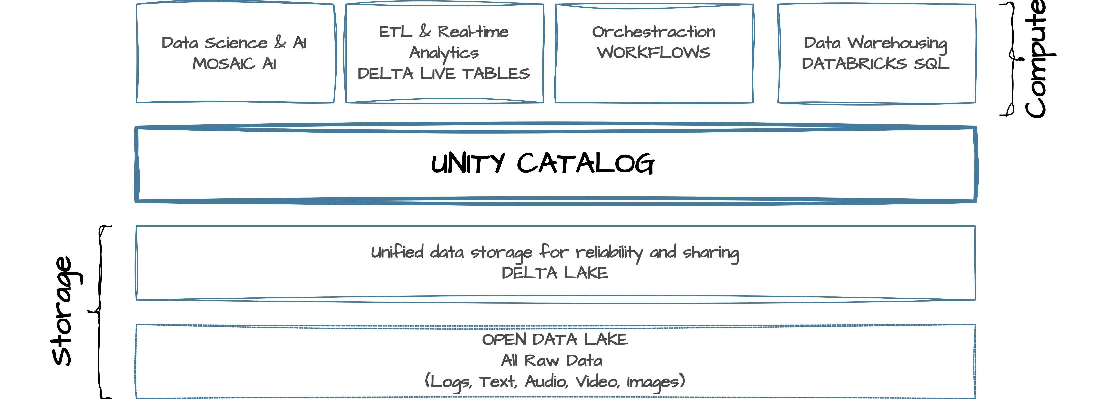
Databricks – Unity Catalog

Slide 10
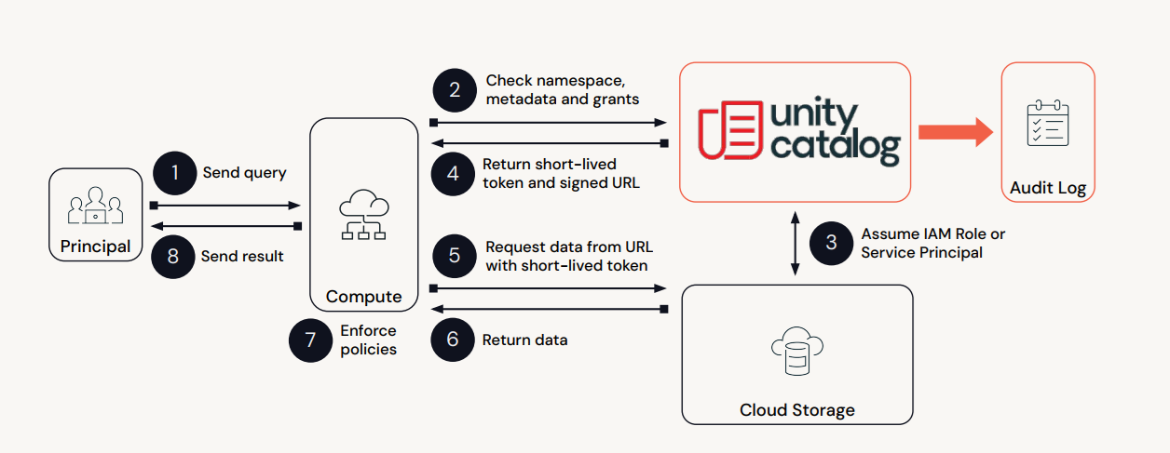
UC- Query Lifecycle
Source: Databrikcs

Slide 11
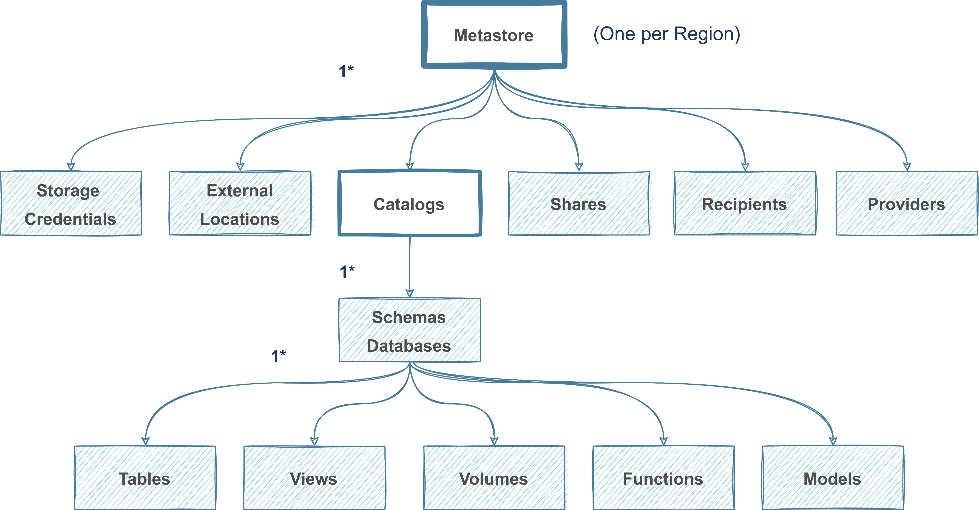
Unity Catalog Structure
Three-Level Namespace
{catalog}.{schema}.{object}

Slide 12
Migration to Unity Catalog
Strategy for migrating to Unity Catalog:
Assess current data architecture
Define your goals and requirements
Plan the migration
Prepare the Unity Catalog environment(s)
Migrate the data and processes
Test the migration
Optimize the performance
Monitor and maintain the Unity Catalog environment

Slide 13
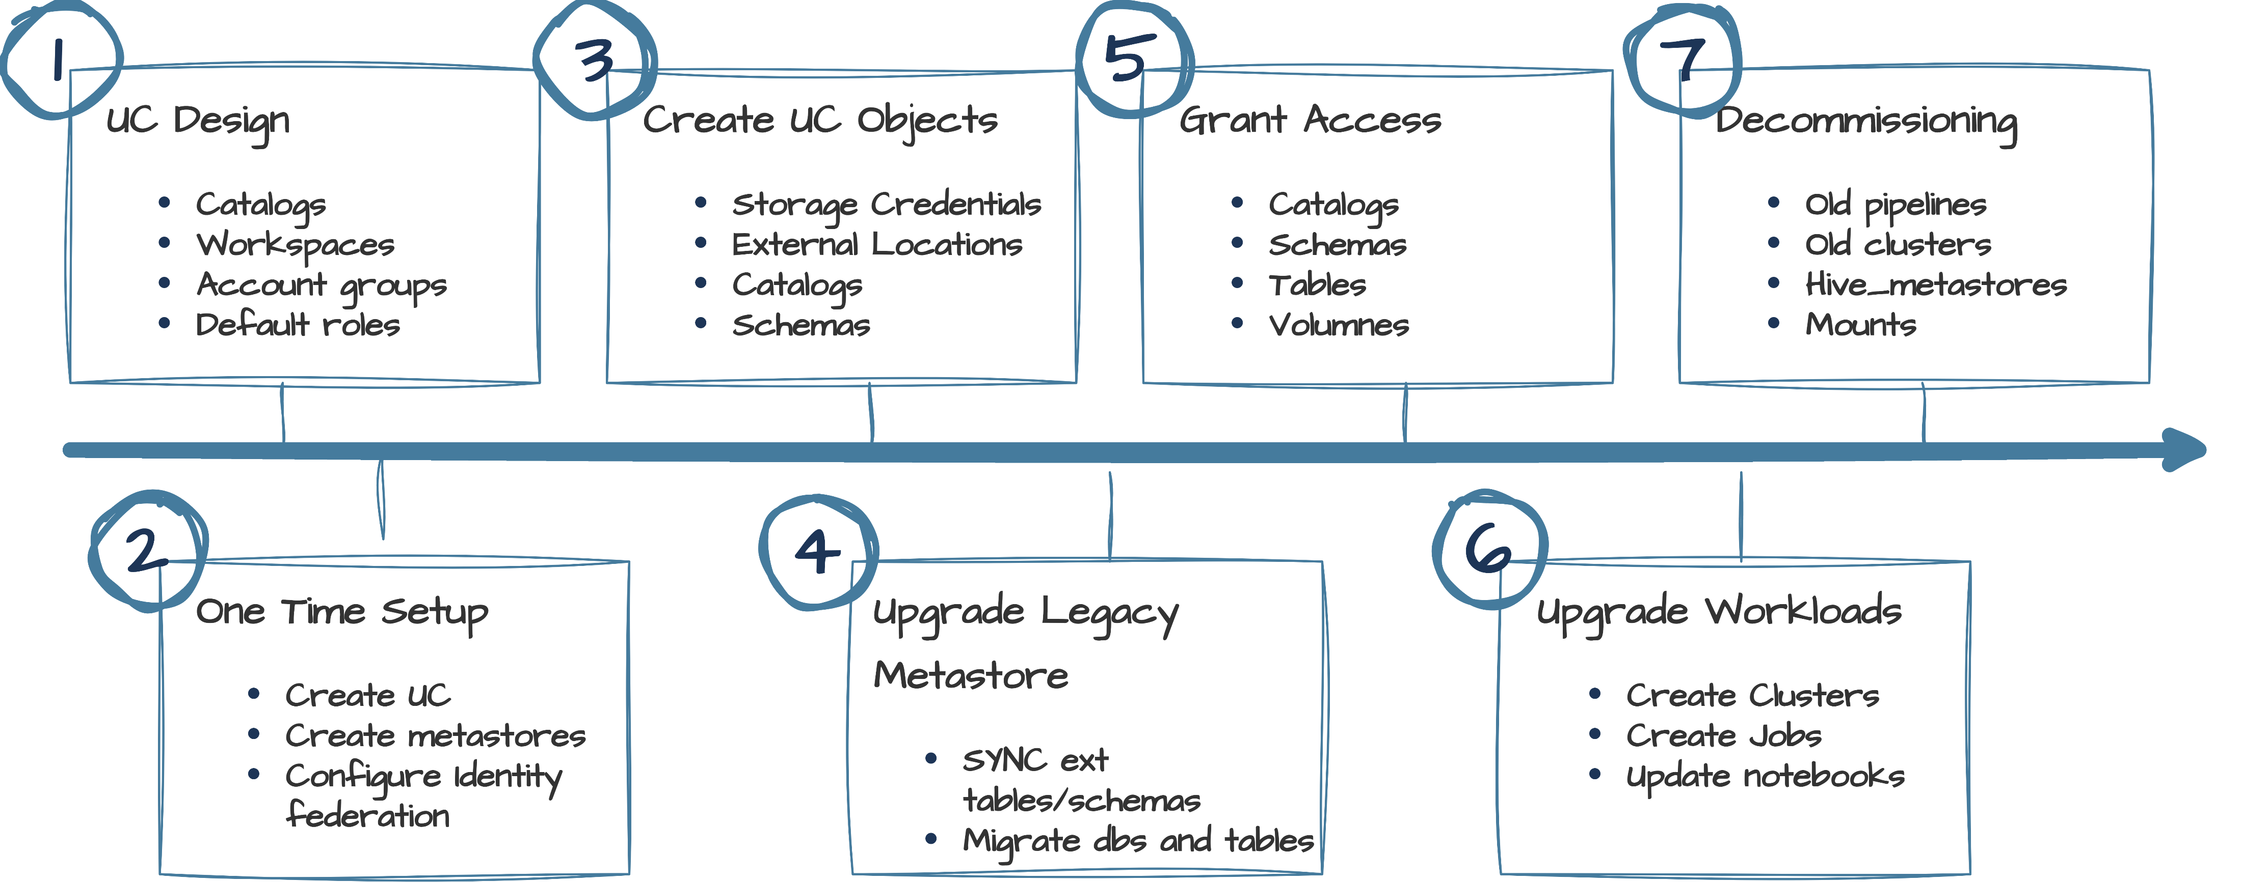
High Level Roadmap to Unity Catalog
Steps to consider for a full upgrade

Slide 14
Assess data architecture
Assess data architecture:
Identify the data sources/stores
Identify the data pipelines
Identify the data consumers
Analyze the performance
Analyze the scalability
Analyze the security
Analyze the compliance (GDPR, HIPAA)
Useful Tools:
UCX
https://github.com/databrickslabs/ucx
Databricks REST API
https://docs.databricks.com/api/workspace/introduction
Databricks SDK
https://docs.databricks.com/en/dev-tools/sdk-python.html
Databricks CLI
https://docs.databricks.com/en/dev-tools/cli/index.html

Slide 15
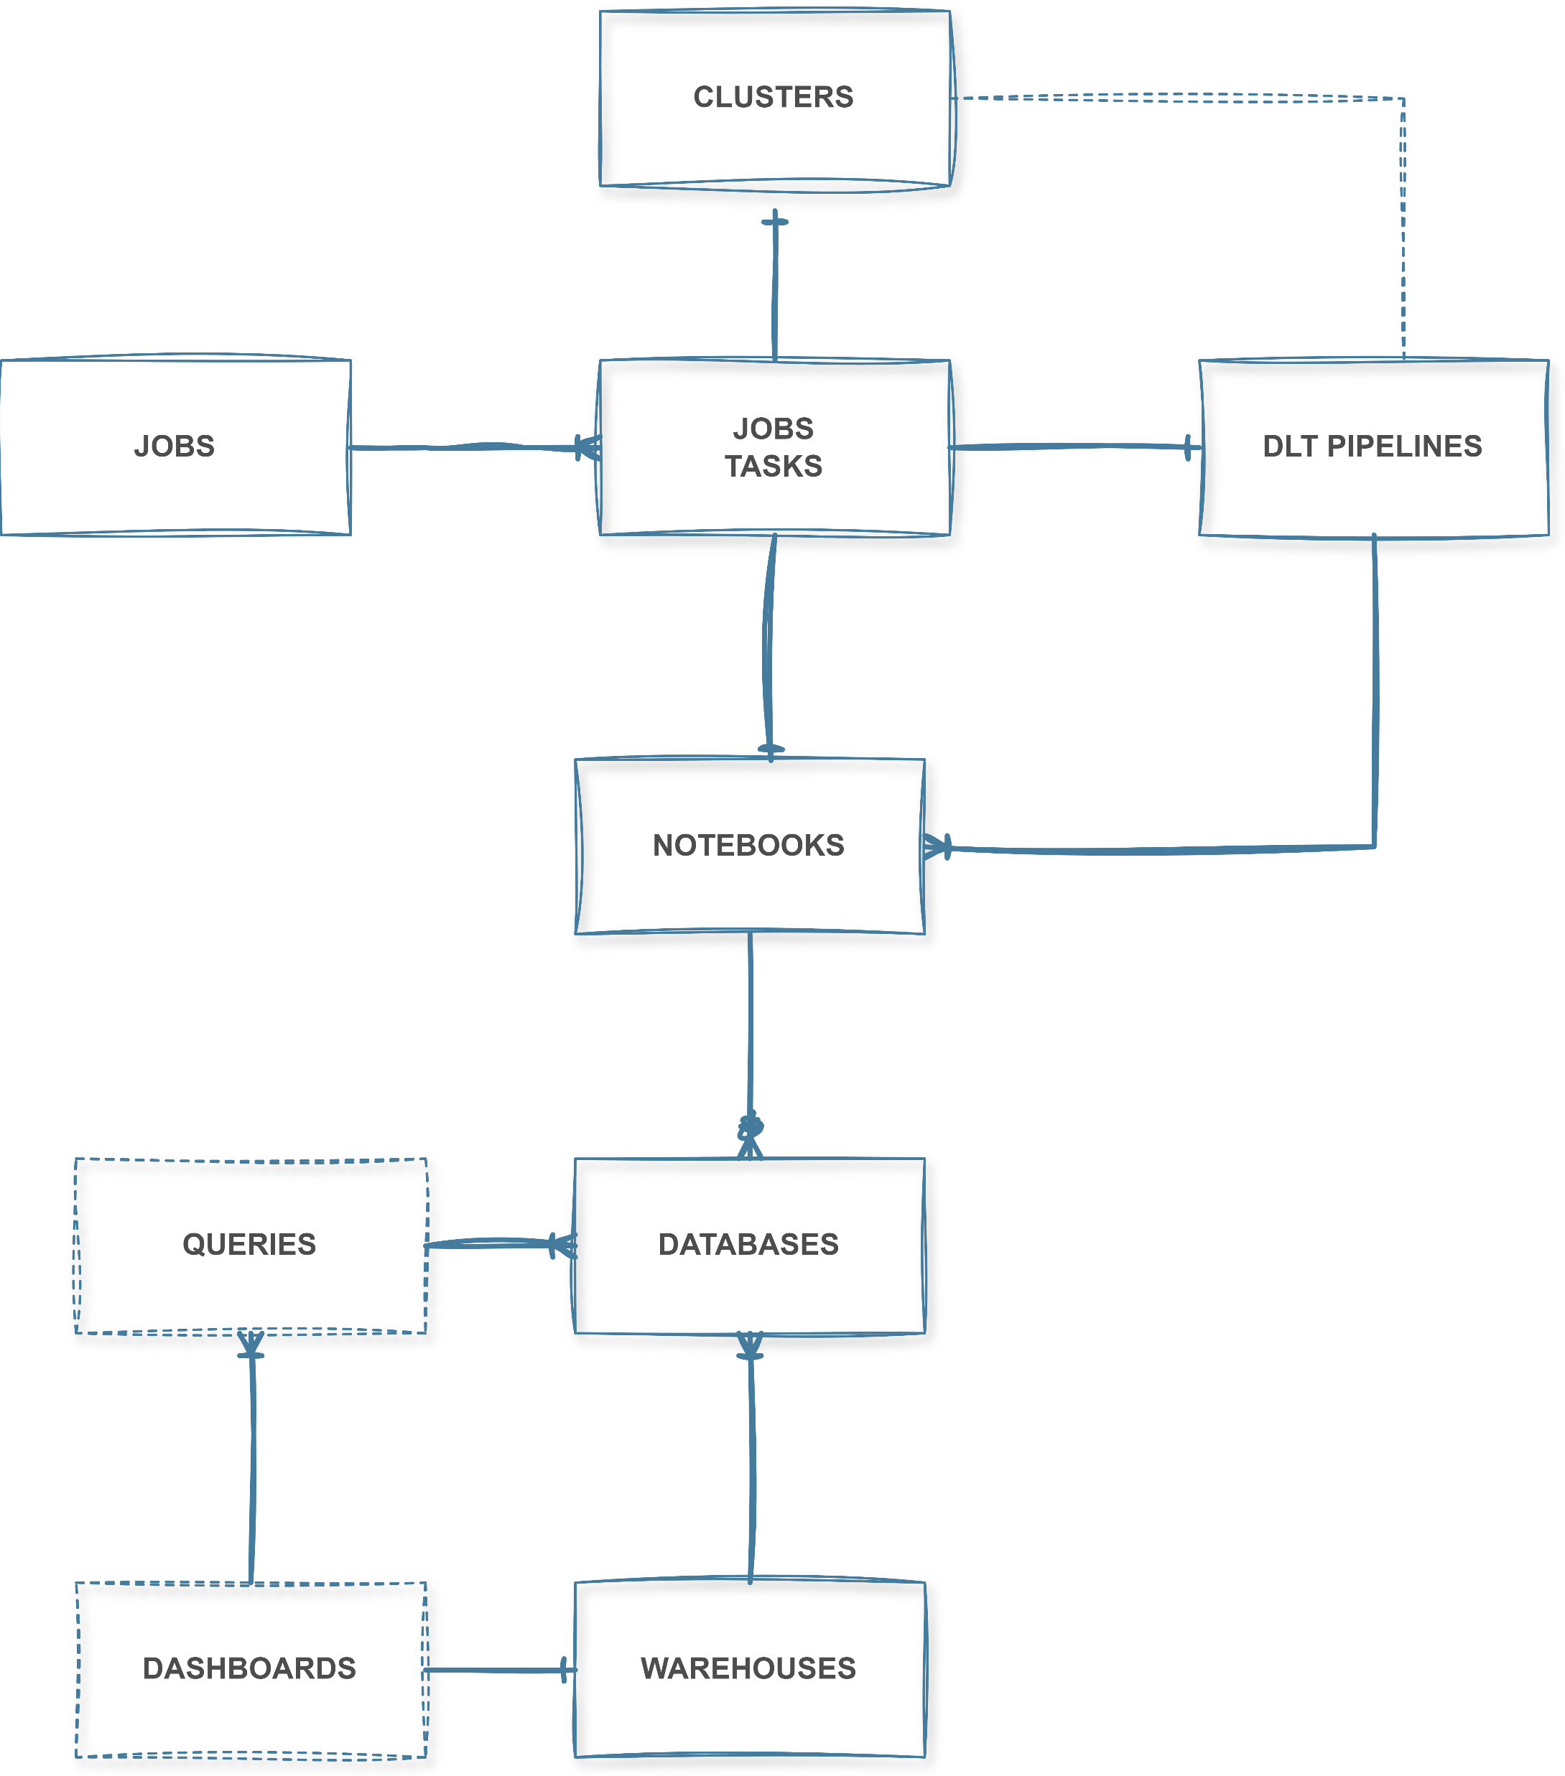
Migrate to Unity Catalog
Migration approaches:
“All in one”
This approach involves migrating all the data
and processes at once.
“Small steps method”
This method involves migrating data and applications in stages or increments. This allows for testing and validation after each step, reducing the risk of downtime or data loss.
Challenges:
Objects dependencies

Slide 16
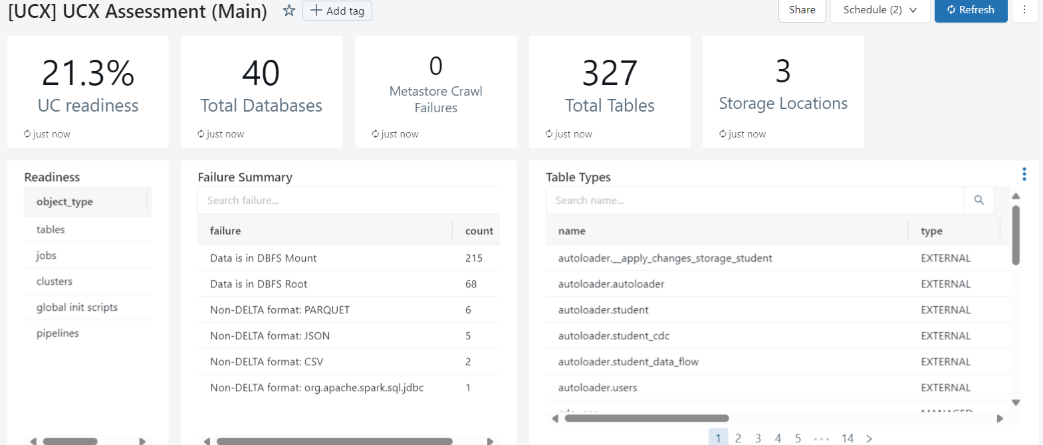
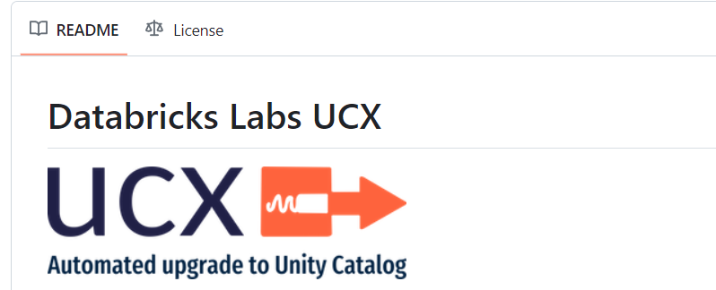
Assess data architecture UCX

Slide 17
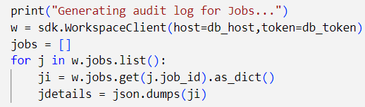
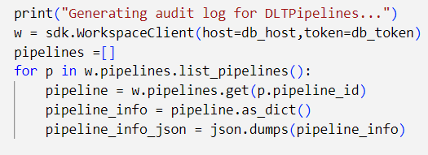
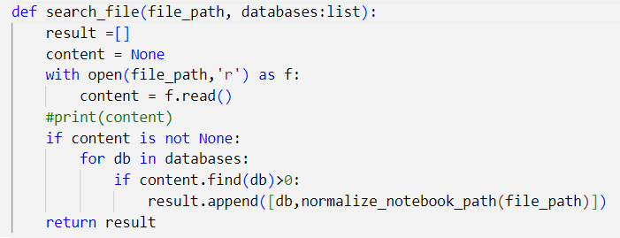
Assess data architecture
Databases:
SHOW DATABASES
Jobs
Databricks SDK
DLT Pipeline
Databricks SDK
Notebooks
Git Repo
Notebooks-Databases
Python Script

Slide 18
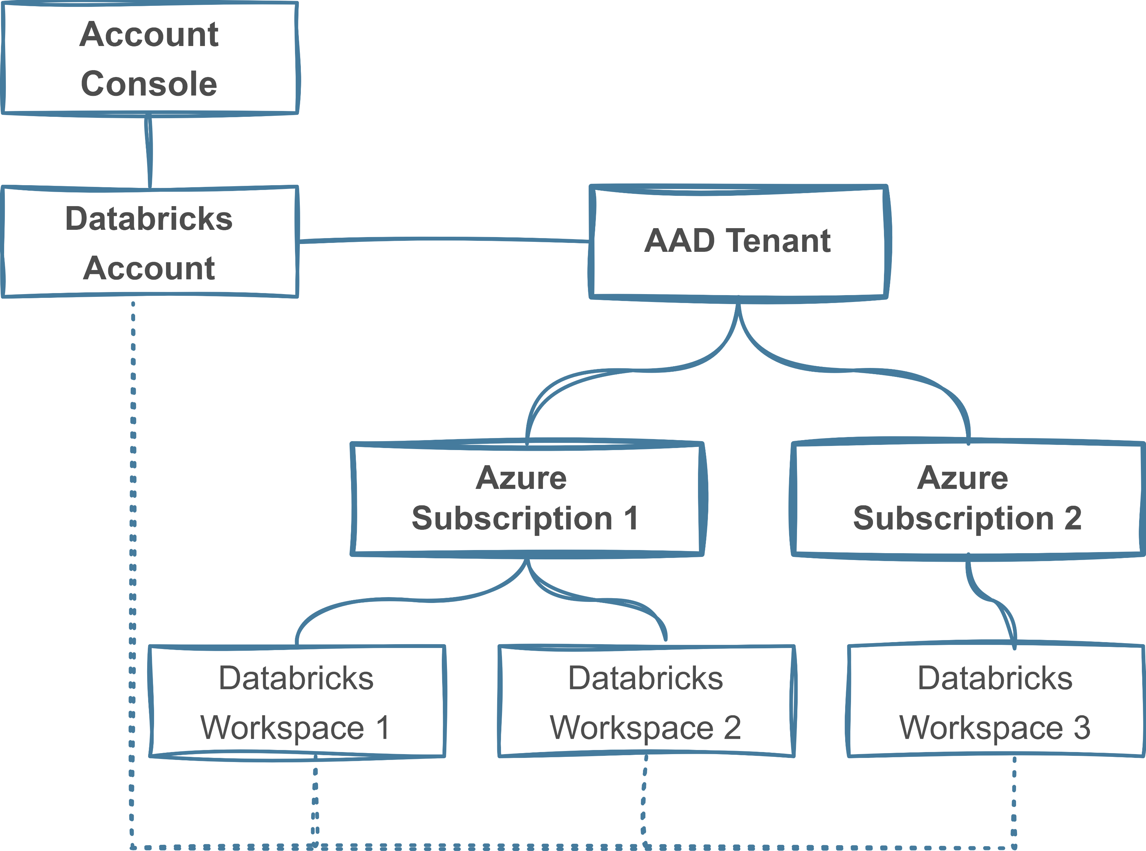

Databricks Unity Catalog on Azure
Account Console:
https://accounts.azuredatabricks.net/
Azure AD Global Administrator role
Access Connector for Azure Databricks
- is an Azure resource that lets you connect managed identities to an Azure Databricks account.
Managed storage
- location in an Azure Data Lake Storage Gen2
container to store data and metadata

Slide 19
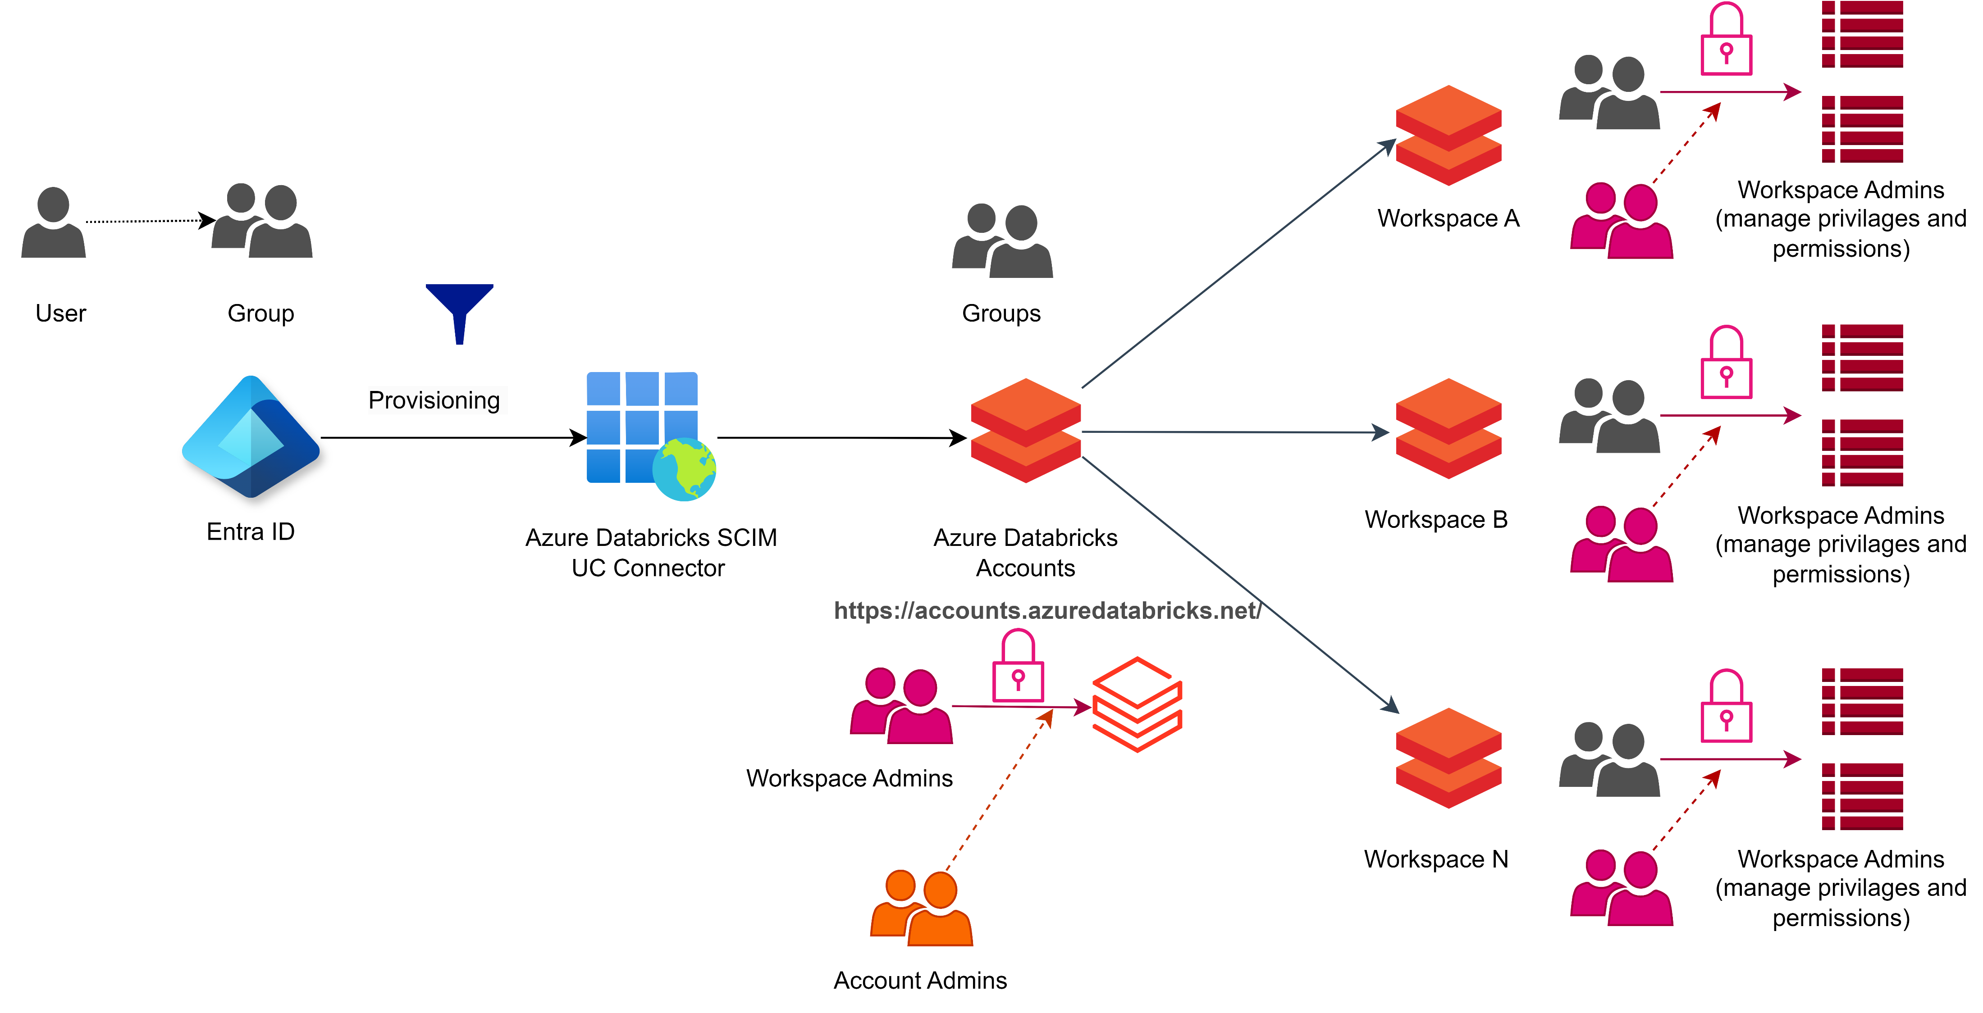
Unity Catalog – Users Management
ENTRA ID – Groups and Users
Permissions only on the Group Level
Account Admins
Workspace Admins
No Local Groups
https://docs.databricks.com/en/admin/users-groups/groups.html#overview-of-group-management
IS_ACCOUNT_GROUP_MEMBER ( account level)
IS_MEMBER (workspace local group)

Slide 20
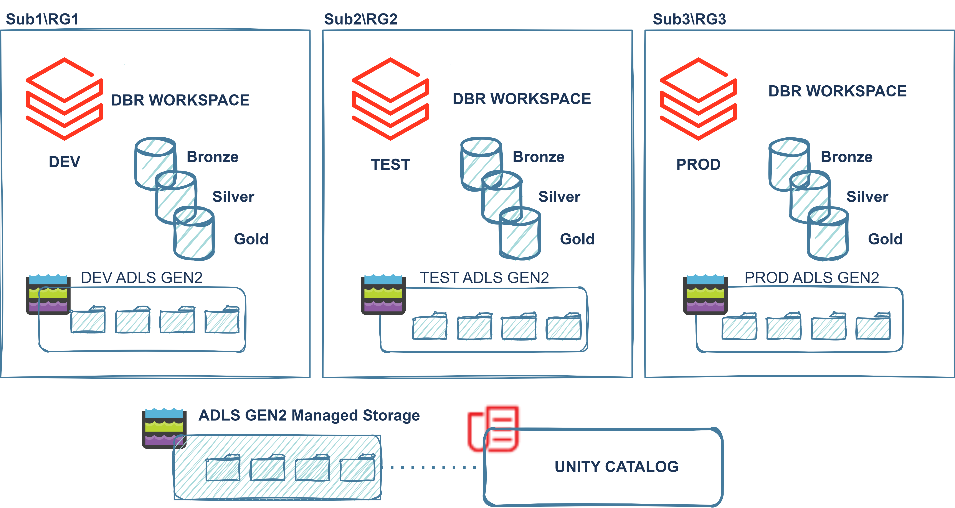
Unity Catalog DBR Workspaces
DBR Workspaces
Technical (Dev, Uat, Prod …)
Business (Sales, Marketing…)
DBR Workspace
Storage
Containers(e.g. Silver, Gold)
Mounting points
Databases
Migration Strategy
Use existing structure and resources
Create new

Slide 21
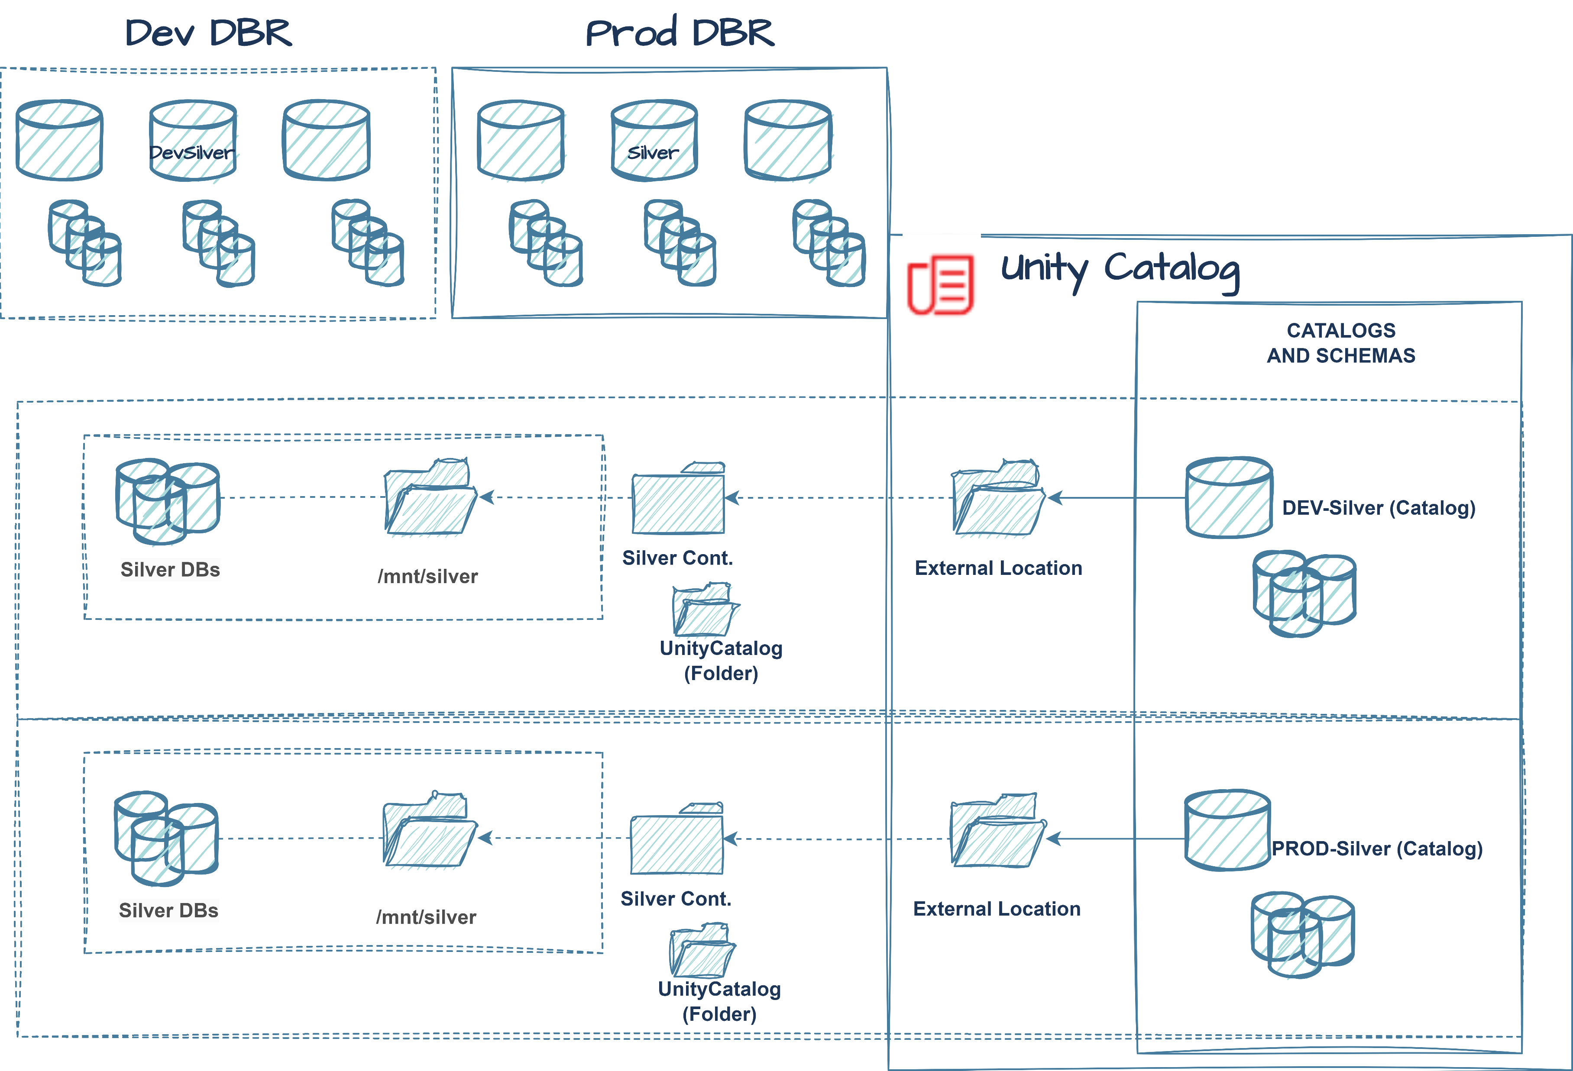
Unity Catalog Structure
OLD WORLD
Storage
Containers
DBR mounting point
One per Zone*
Databases
Location /mnt/
UNITY CATALOG
Storage
Container
Folder Unity Catalog
DBR external location
Catalog (external location)
DBS in Catalog

Slide 22
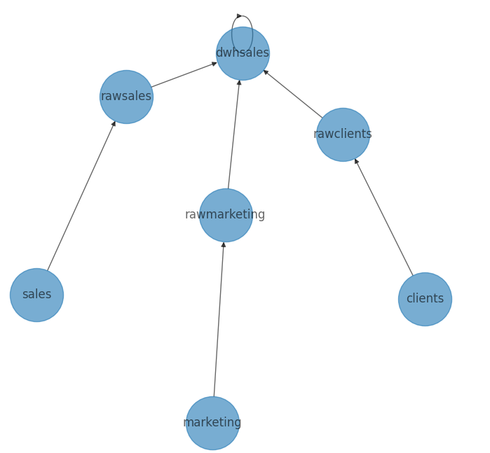

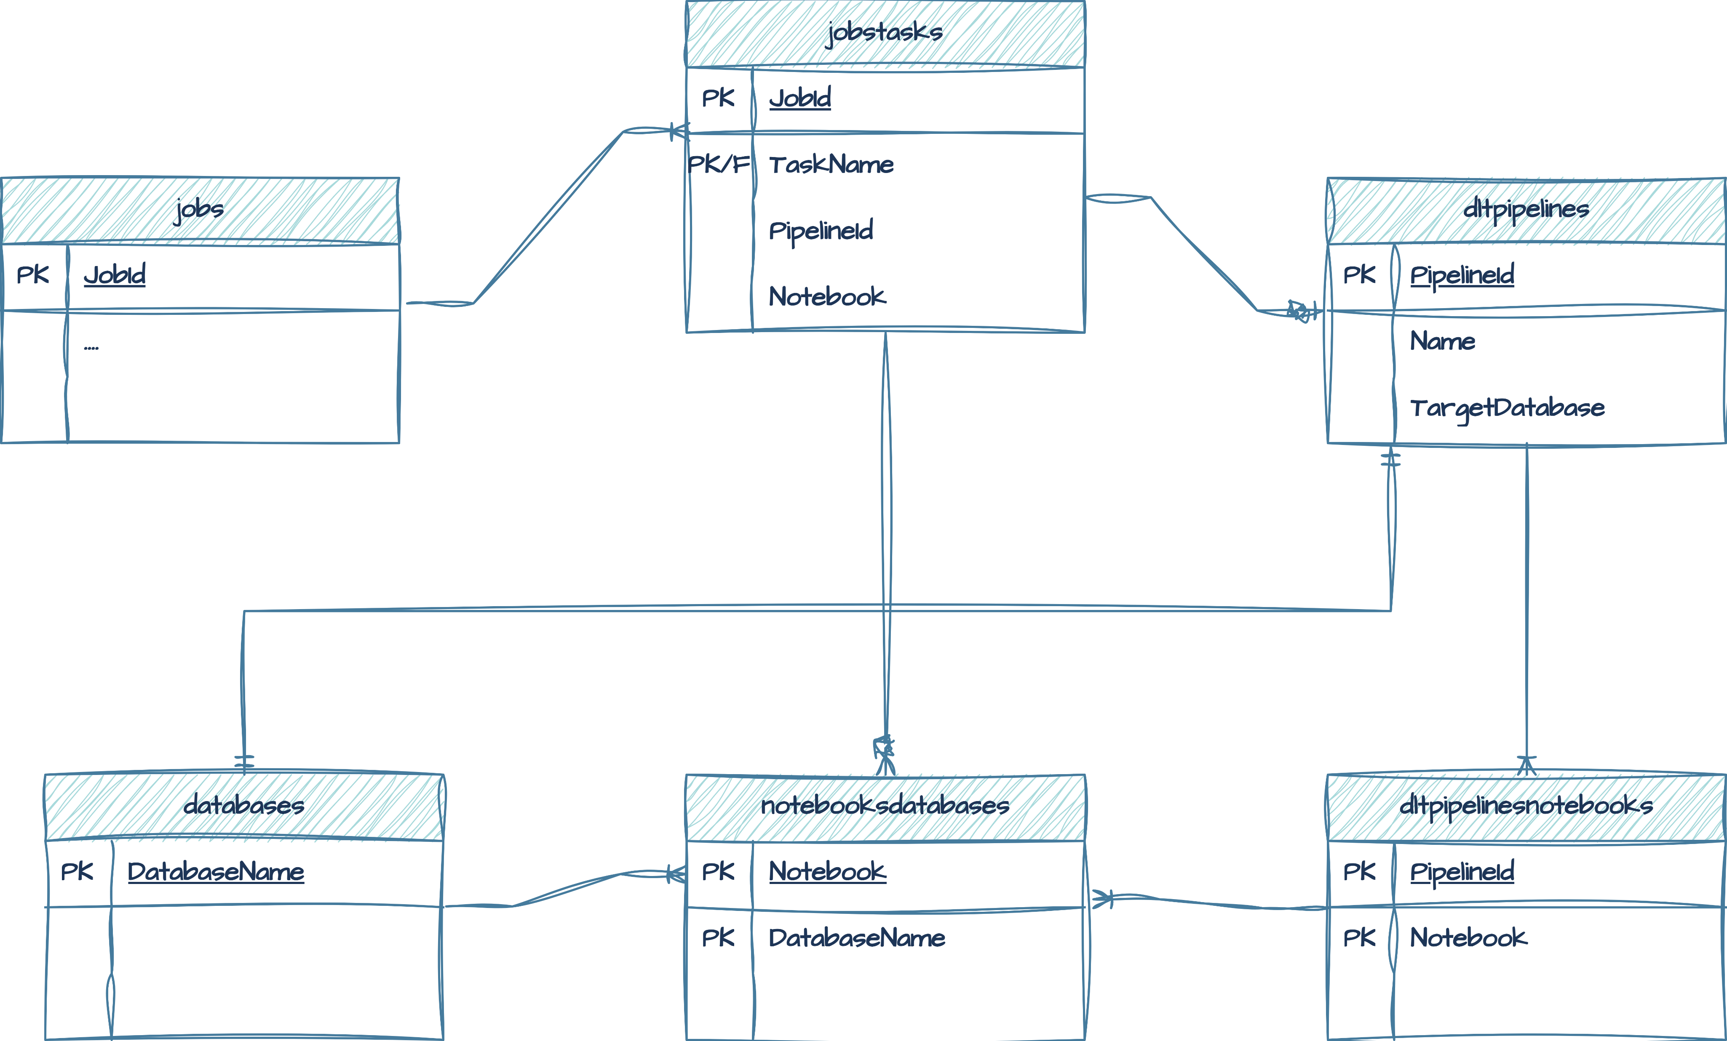
Migration to Unity Catalog
Databases Dependencies Graph
UNITY CATALOG
Three-Level Namespace
{catalog}.{schema}.{object}
Access to Hive metastore objects
hive_metastore.{DBName}.{ObjectName}
Assessment/Audit Objects

Slide 23
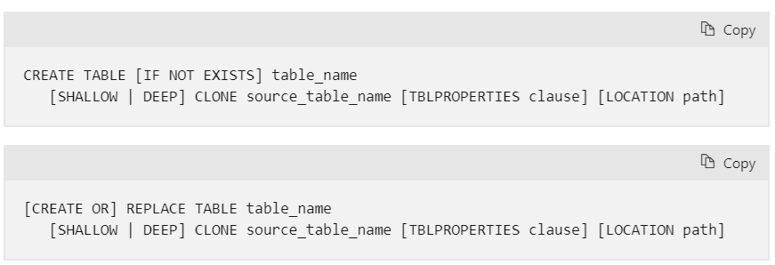
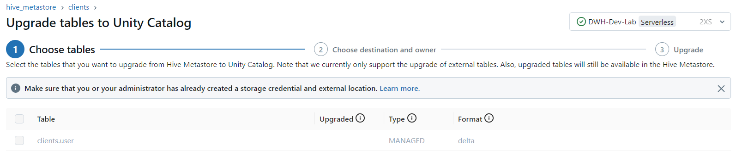
Data Migration
Tools:
UCX
https://github.com/databrickslabs/ucx
Unity Catalog upgrade wizard
SYNC SQL command
CREATE TABLE CLONE SQL command

Slide 24
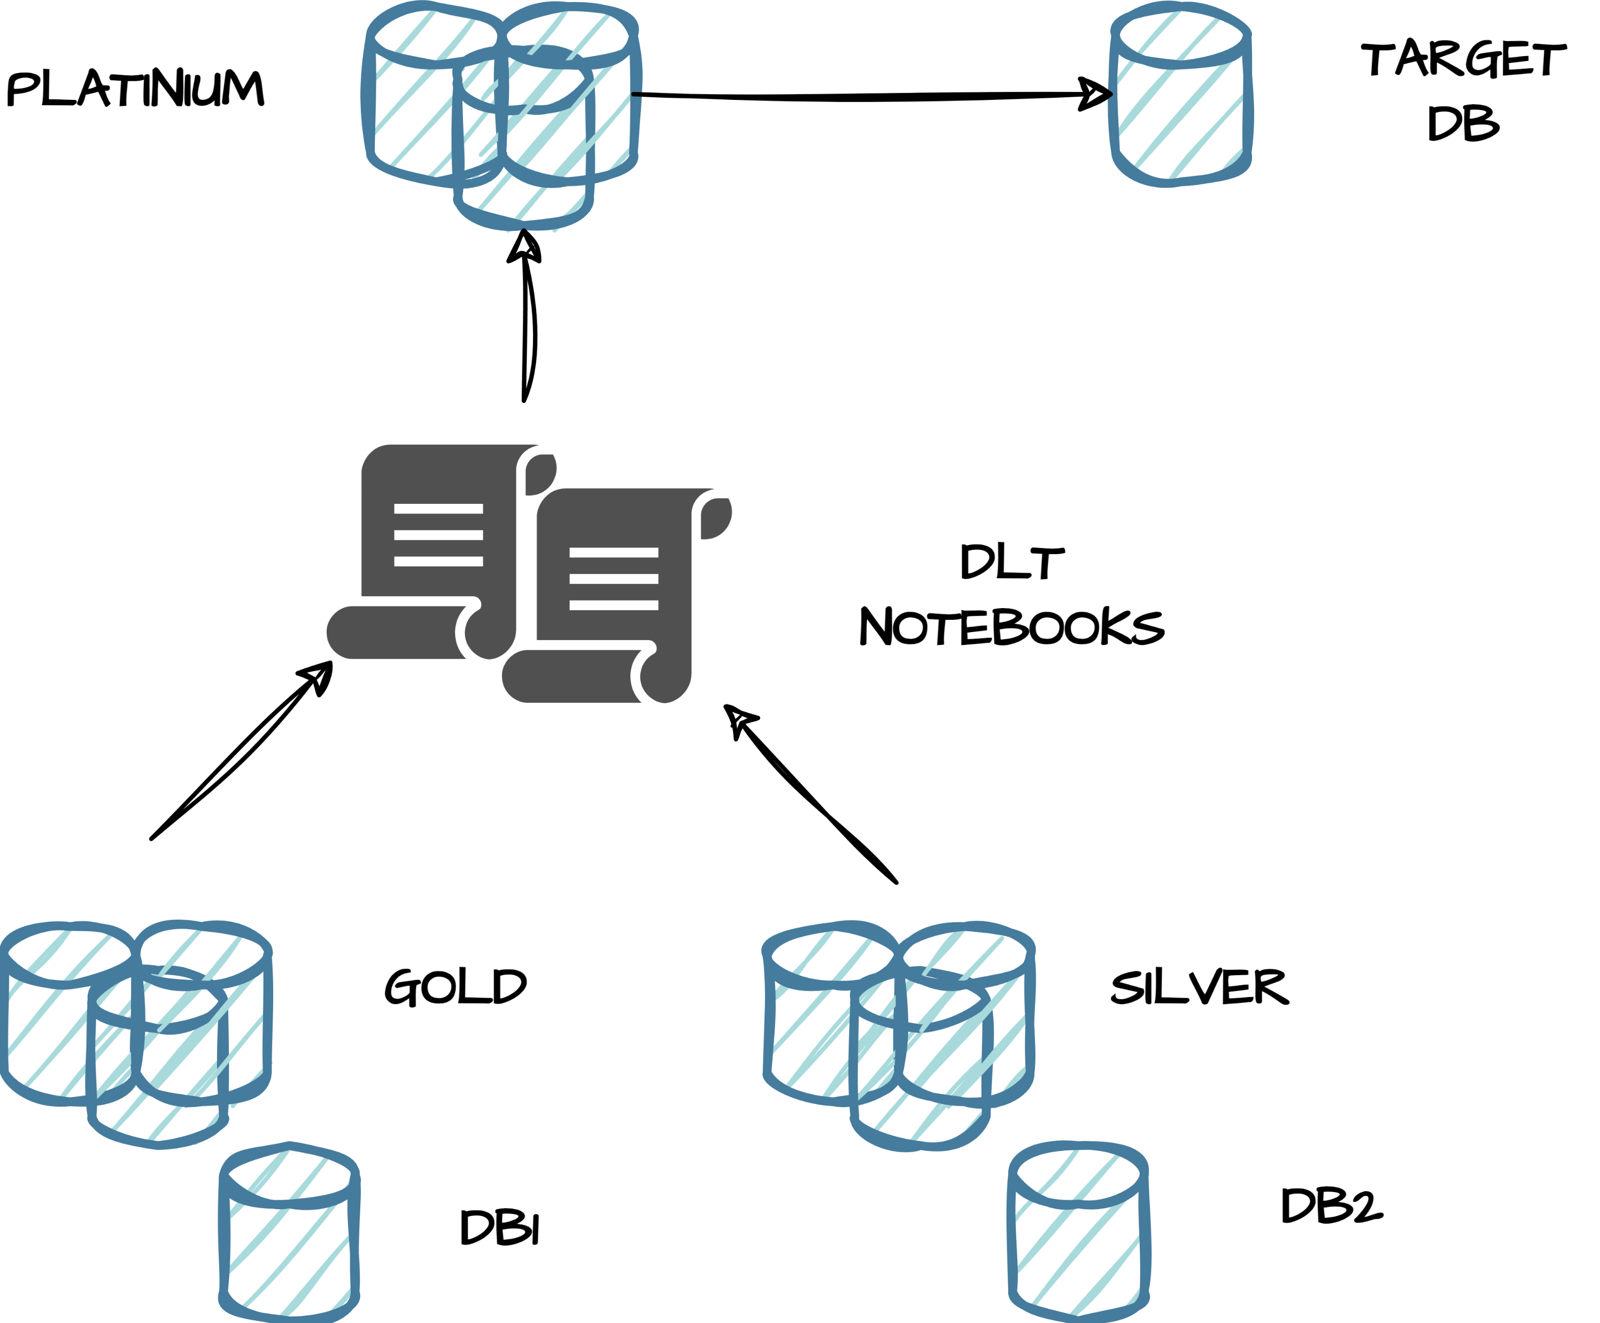
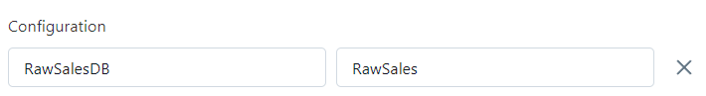
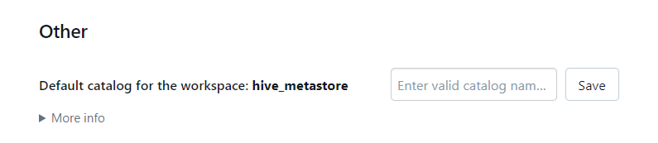
Processes Migration
Compute:
Migrate existing all-purpose cluster
New Clusters – Cluster Policies
Processes:
Jobs /Workflows
Notebooks/Scripts/Queries…
Three level namespace
Delta Live Tables
Notebooks
Three level namespace
Pipelines/Notebooks Parametrization
Spark configuration settings:
spark.databricks.sql.initial.catalog.name
(overrides the default catalog for a specific cluster)

Slide 25
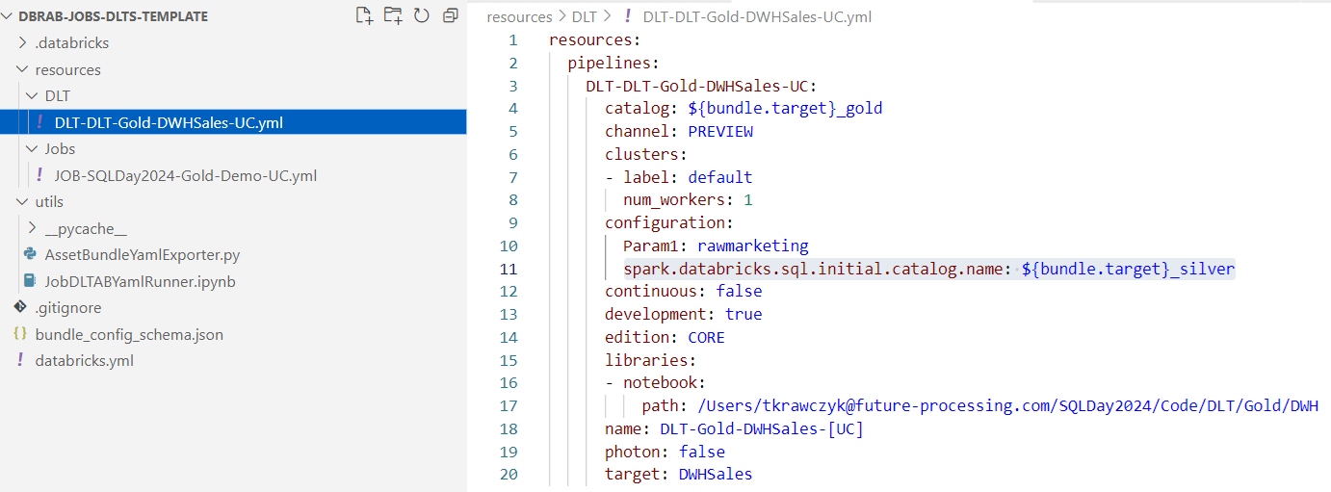
Processes Migration
Databricks Asset Bundles
Databricks Asset Bundles (DABs) are a new tool for streamlining the development
of complex data, analytics, and ML projects for the Databricks platform.

Slide 26
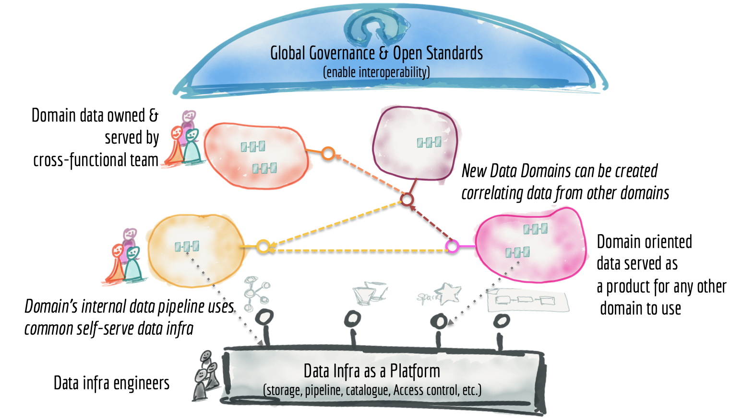
Unity Catalog -Benefits
Centralized data management
Unity Catalog provides a single place to manage all your data assets, simplifying data discovery, access, and governance.
Improved collaboration
With a unified catalog, teams can easily share and access data across the organization, promoting collaboration and reducing data silos.
Enhanced security
Unity Catalog offers robust security features, such as column-level access control and data encryption, to ensure that your data is protected.
Better data quality
By centralizing data management, Unity Catalog helps ensure that data is consistent, accurate, and up-to-date, improving data quality and reliability.
Increased productivity
Unity Catalog simplifies data management tasks, such as data discovery, access, and integration, freeing up time for more value-added activities.
Source:
https://martinfowler.com/articles/data-monolith-to-mesh.html#TheParadigmShiftTowardsADataMesh
Centralized:
Governance policies applied by a central team
Production of data artifacts managed by a central team
Distributed:
Domain driven production of data artifacts
Entitlements on data owned by domain teams

Slide 27
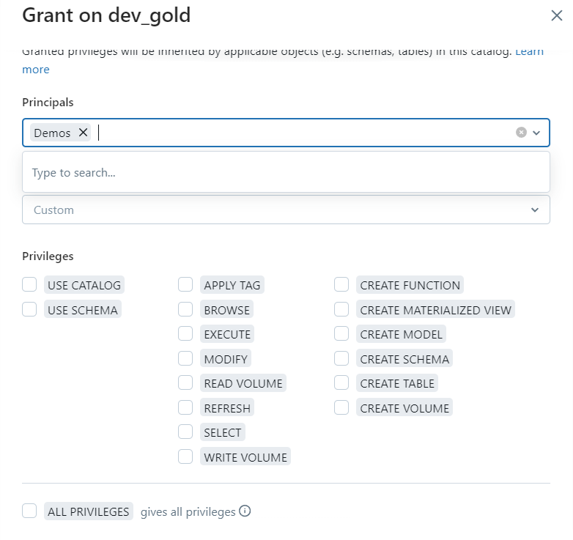
Unity Catalog – Permissions
The security model in Databricks Unity Catalog uses ANSI SQL standards.
GRANT/REVOKE privilege_types ON securable_object TO principal

Slide 28
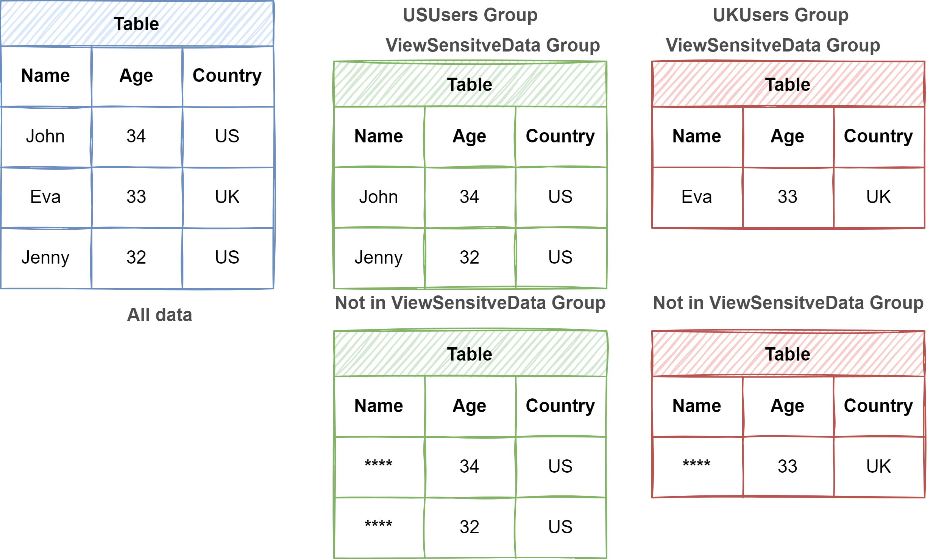
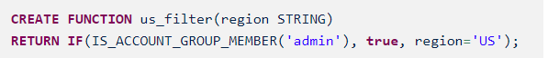
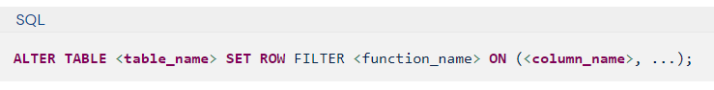
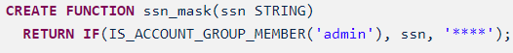
Unity Catalog -Security Row filters and column masking
IS_ACCOUNT_GROUP_MEMBER ( account level)
IS_MEMBER (workspace local group)
ROW FILTER FUNCTION
COLUMN MASKING FUNCTION
Limitations:
Delta Live Tables materialized views and streaming
tables don’t support row filters or column masks.

Slide 29
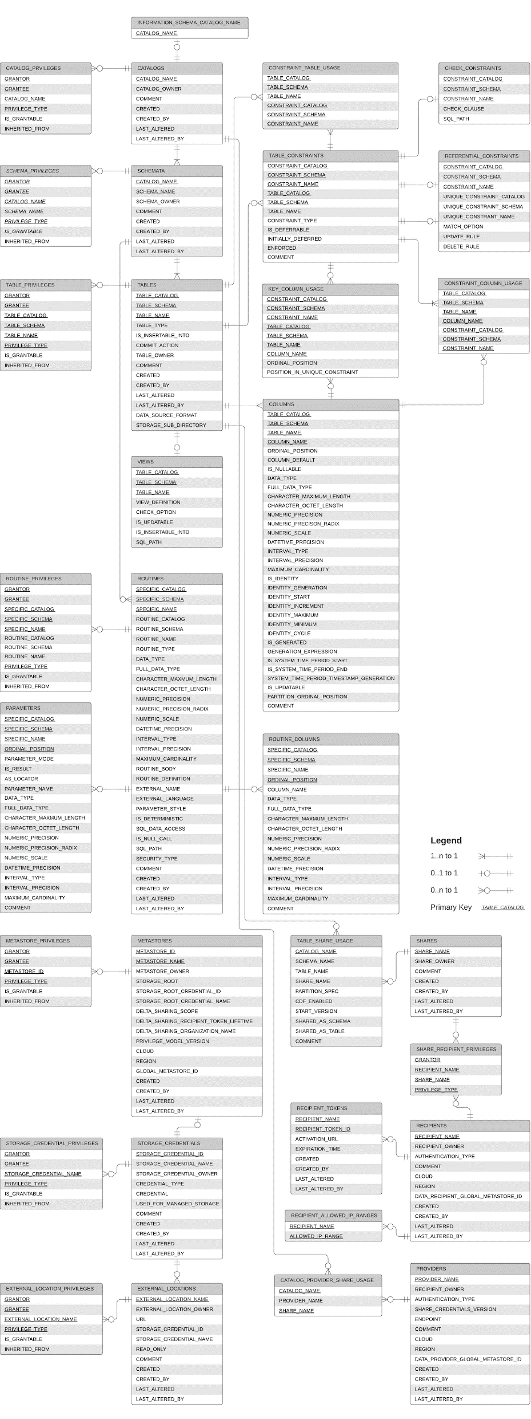
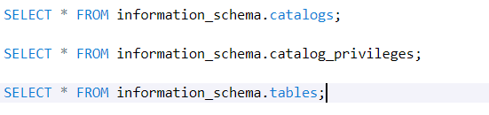
Unity Catalog –Auditing
The INFORMATION_SCHEMA is a SQL standard based schema, provided in every catalog created on Unity Catalog.
System tables are an Databricks-hosted analytical store of your account’s operational data
Audit logs: Located at system.access.audit.
Billable usage logs: Located at system.billing.usage.
Pricing table: Located at system.billing.list_prices.
Table and column lineage: Both tables located under system.access.
Marketplace listing access: Located at system.marketplace.listing_access_events.

Slide 30
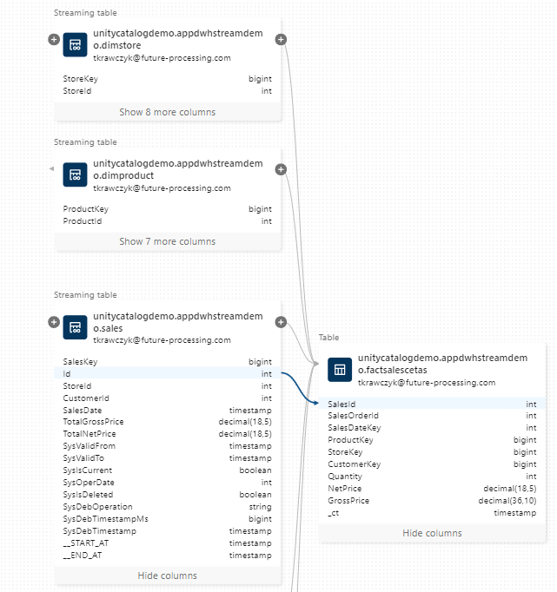
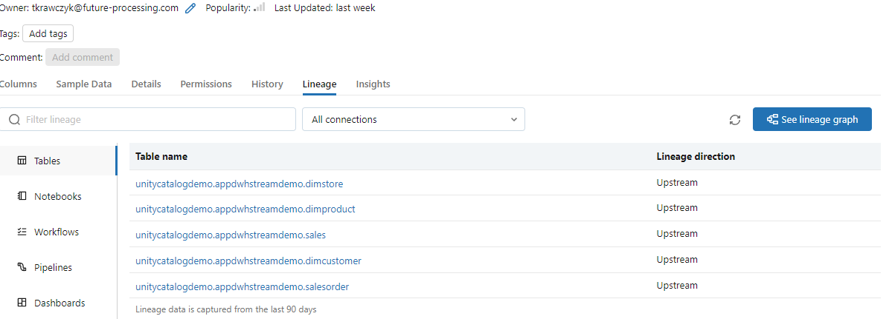
Unity Catalog
Data Lineage
Data Lineage is supported for all languages and is captured down to the column level. Lineage data includes notebooks, workflows, and dashboards related to the query.
Notes:
End-to end visibility into how data flows and consumed in your organization

Slide 31
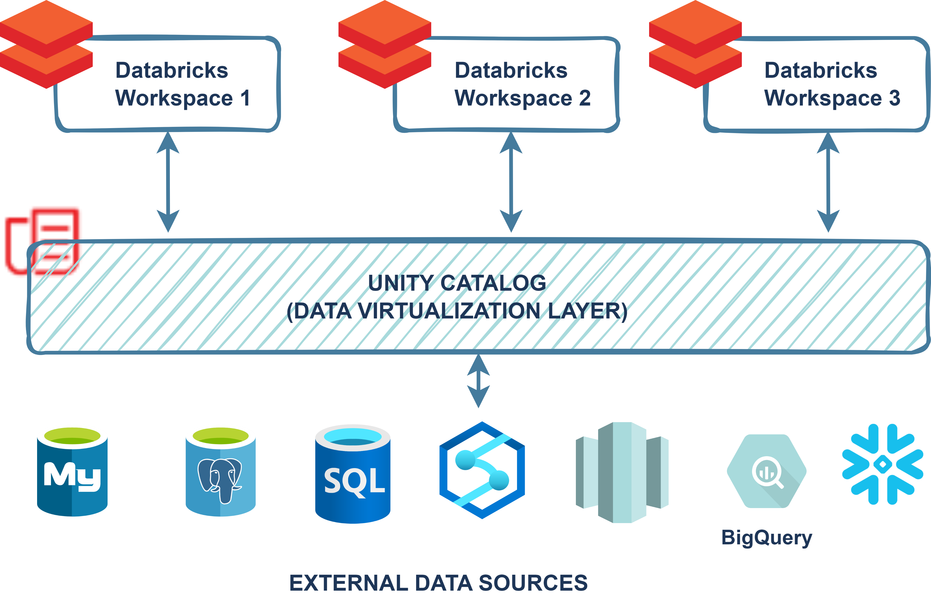
Unity Catalog – Lakehouse Query Federation
Lakehouse Query Federation provides one
single secure access to all your data.
Supported data sources:
MySQL ,PostgreSQL,Amazon Redshift, Snowflake,
Azure SQL Database, Azure Synapse,
Google’s BigQuery …
MS Fabric - Microsoft Fabric Community Conference
Unity Catalog provides:
Unified permission controls
Intelligent pushdown optimizations
Accelerated query performance with Materialized view
Support for R/O operations

Slide 32
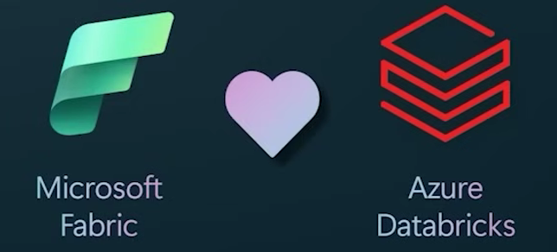
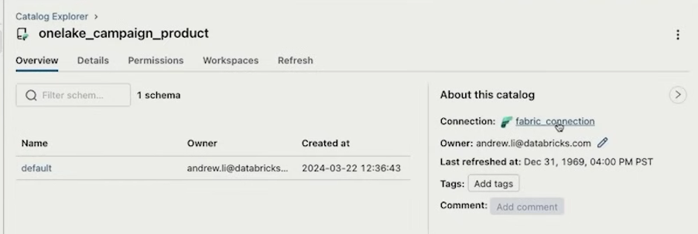
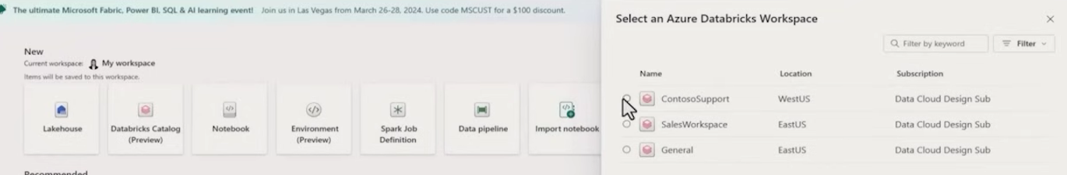
Microsoft Fabric and Databricks
Microsoft Fabric Community Conference

Slide 33
DEMO TIME

Slide 34
Q & A

Slide 35
Resources
https://www.databricks.com/product/unity-catalog
https://www.databricks.com/resources/demos/tutorials?itm_data=demo_center
https://learn.microsoft.com/en-us/azure/databricks/sql/language-manual/sql-ref-information-schema
https://learn.microsoft.com/en-us/azure/databricks/administration-guide/system-tables/
https://www.databricks.com/resources/demos/tutorials?itm_data=demo_center
Microsoft Fabric Community Conference

Slide 36
THANK YOU!
tkrawczyk@future-processing.com
tomasz.k.krawczyk@gmail.com

